Slide 2
Apache Beam and Ensemble Modeling: A Winning Combination for Machine Learning
Shubham Krishna ML Engineer, ML6

Slide 3

Who is ML6?
Machine Learning services company.
We help our clients build
machine learning applications using technologies such as Apache Beam.

Slide 4
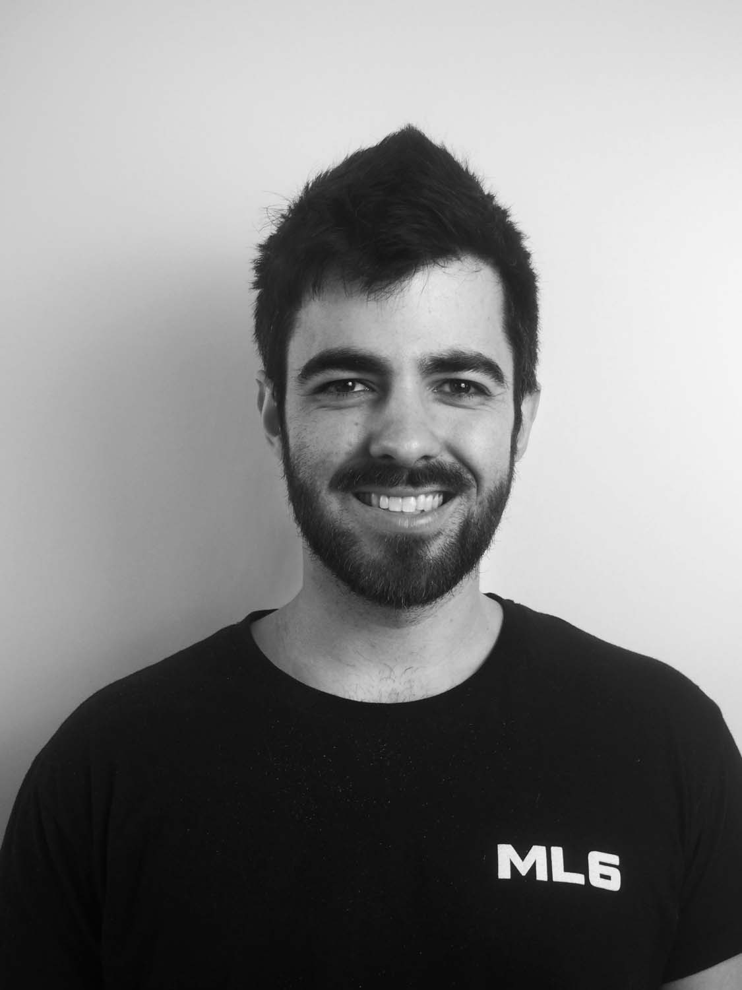
Credits
Philippe Moussalli
Machine Learning Engineer, ML6
Notes:
Credits to Philippe, my colleague working at Belgium Office
He worked & developed initial pipeline with Apache beam 2.40.0

Slide 5
Agenda
Motivation
Ensemble Modeling for solving complex use-cases
Solution
Beam RunInference:
Seamless integration of ML in a Beam pipeline for semantic enrichment
Use multiple Runinference transforms for pipelines with multiple ML models
Example
Notes:
Real life problems require multiple models as you are solving different problems at the same time

Slide 6
Motivation
Semantic Enrichment: ML models provide semantic information.
Business needs often involve the use of multiple machine learning models, each addressing a specific subtask and contributing unique capabilities.
Notes:
ML model can solve a lot of tasks as they add semantic information to the data. Helps in better understanding.

Slide 7
Semantic Enrichment of Data
Categorise: Add specific label
Summarize
Sentiment Analysis
Translate
Extract important keywords
Image Annotation
Image Captioning
Speech Recognition
…..
Notes:
This helps in understanding customer feedback, social media sentiment, or user opinions, enriching the data with sentiment scores or labels.

Slide 8
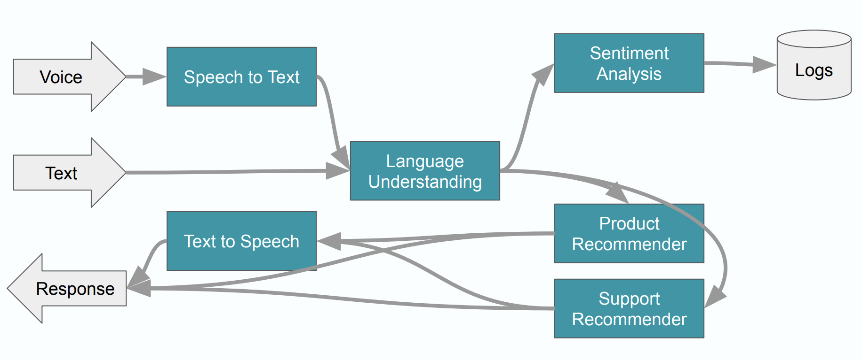
Ensemble Modeling
Fig.1. Example of a Multi model pipeline, taken from a tutorial on RunInference on Dataflow: Link
Notes:
Example of a real-life solution to a problem of a chat bot.

Slide 9
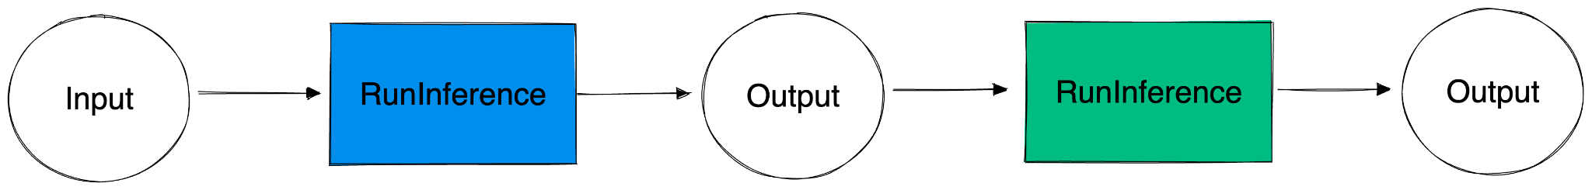
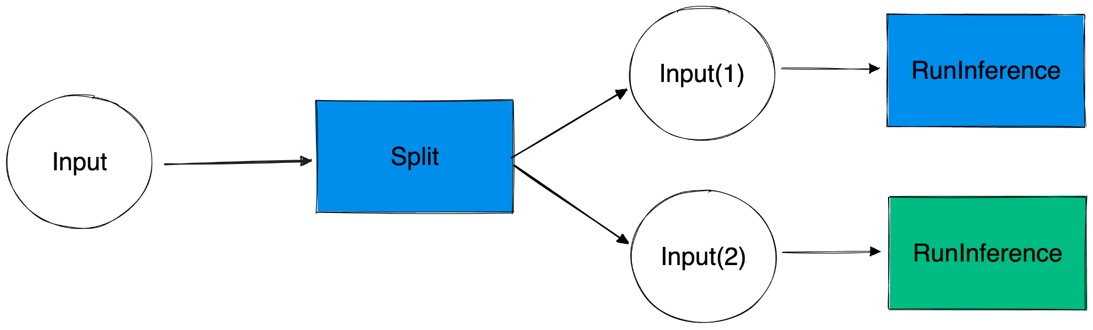
Ensemble Modeling: Sequential vs A/B
Text and horizontal image
Sequential Pattern
A/B Pattern
PAGE NUMBER
Notes:
A/B pattern: Useful for (A/B testing) and that you can do custom partitions (e.g. 50/50)

Slide 10
Problem
Solution
Seamlessly integrate ML models in a Beam pipeline for semantic enrichment of data.
RunInference API = Inference with ML model in batch and streaming pipelines, without needing lots of boilerplate code.
Business needs require combining multiple ML models. (Ensemble Modeling)
RunInference API = Using multiple RunInference transforms, build a pipeline that consists of multiple ML models.

Slide 11
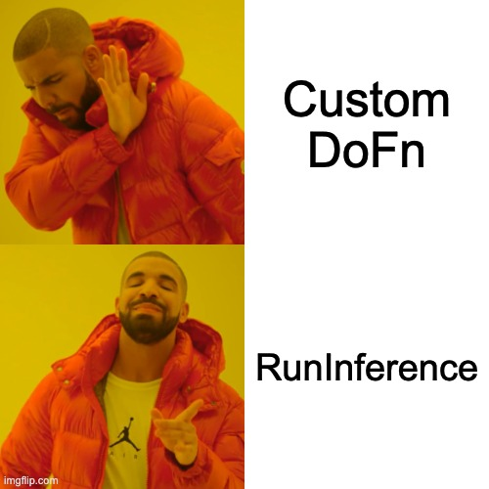
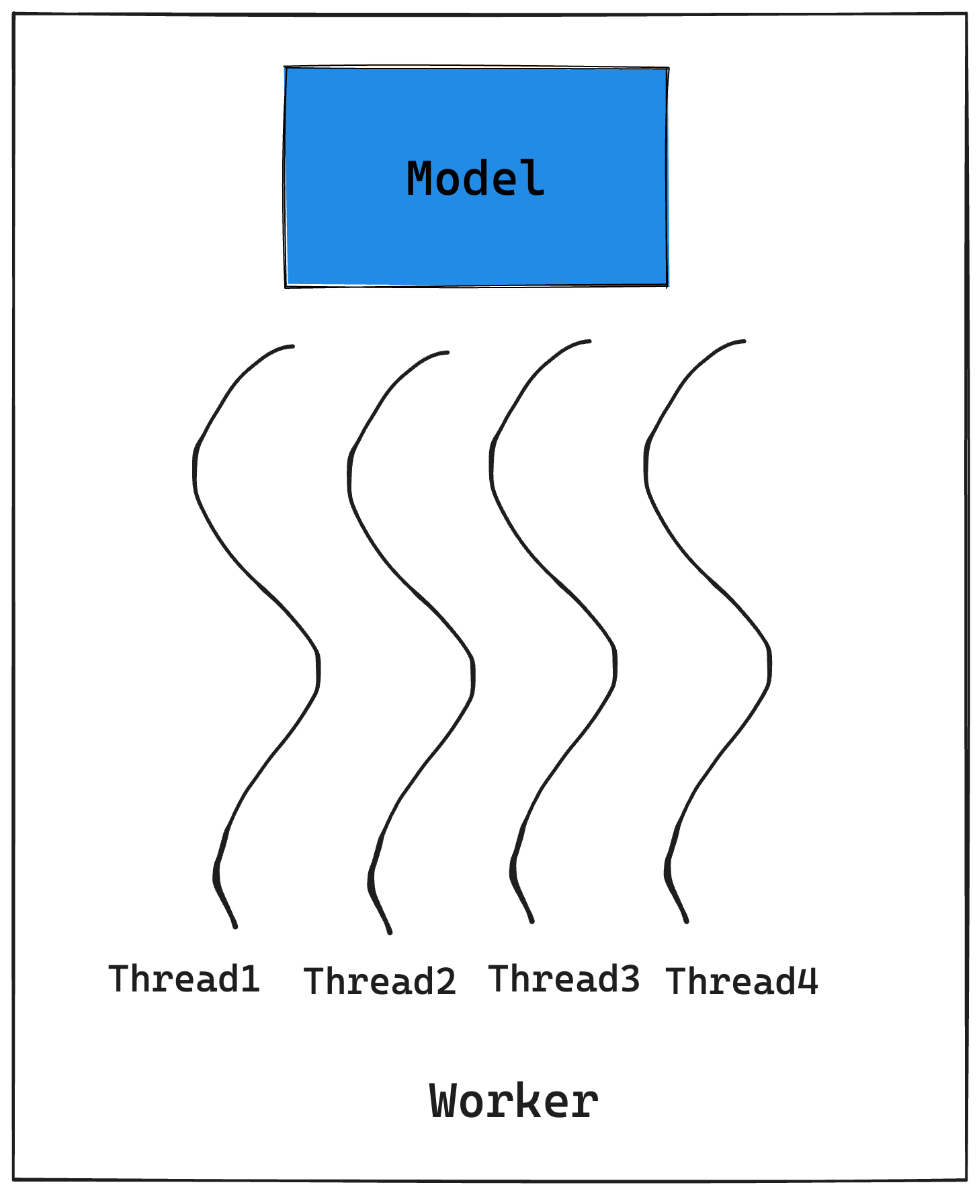
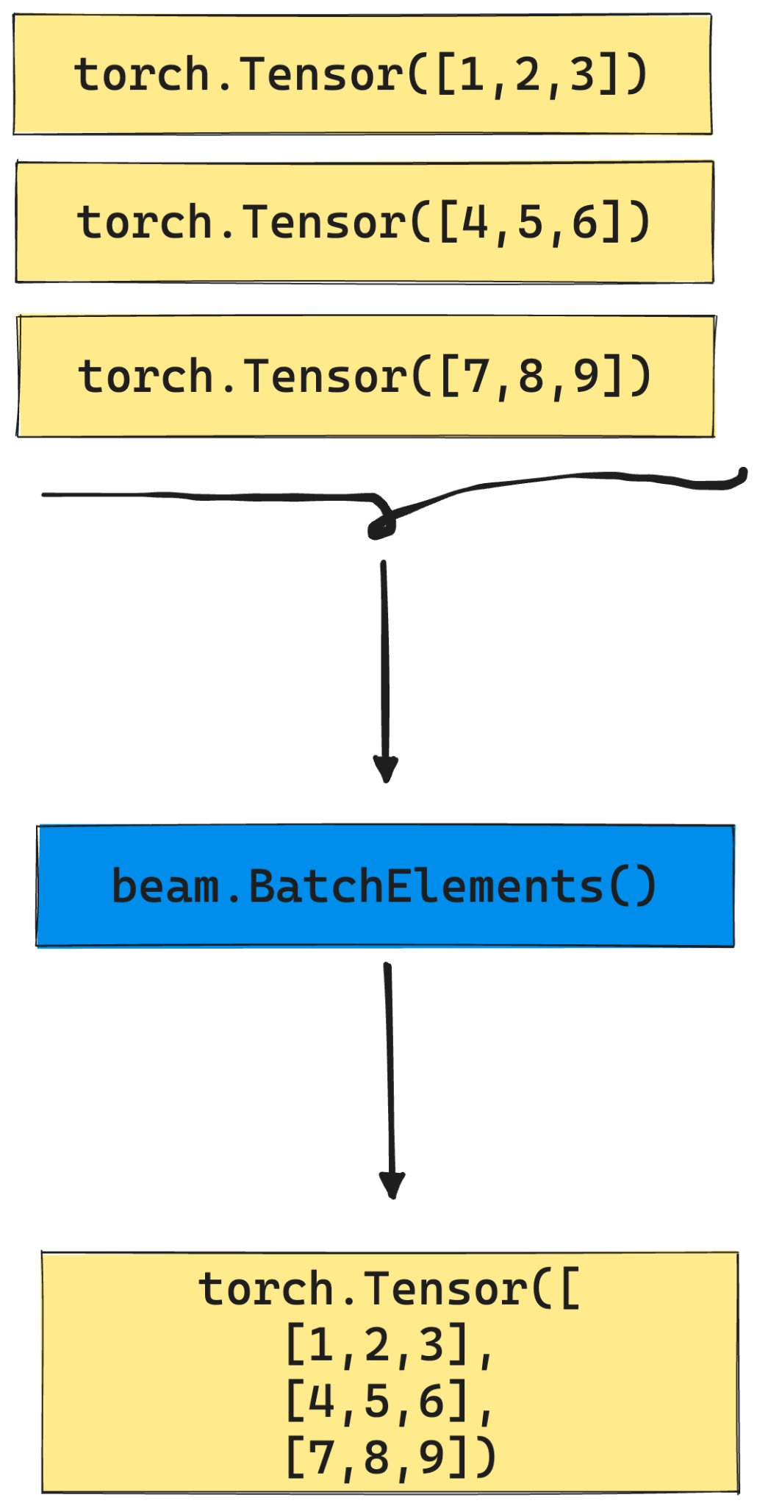
RunInference >> Custom DoFn
Seamlessly integrate ML model in a Beam pipeline for semantic enrichment of data.
Notes:
Before, RunInference was there, write lots of boilerplate code,
Do fn: load model, based on framework, Handle yourself batching, shared class of model,
Error handling, metrics like mean batch latency
Do fn: good for prototyping

Slide 12






RunInference supports popular ML frameworks

Slide 13
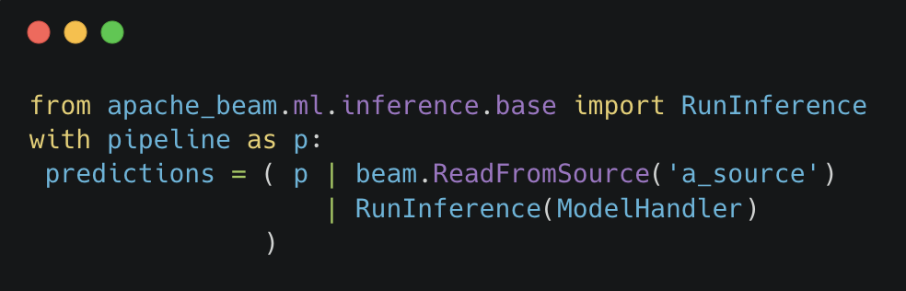
How to use RunInference ?
Notes:
Just one import statement, and pass the model handler to the RunInference

Slide 14
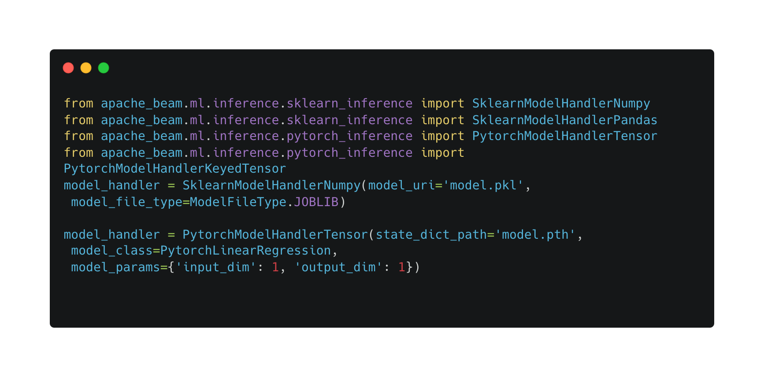
ModelHandlers
Notes:
ModelHandler is a configuration that informs RunInference about the model details and that provides type information for the output.

Slide 15
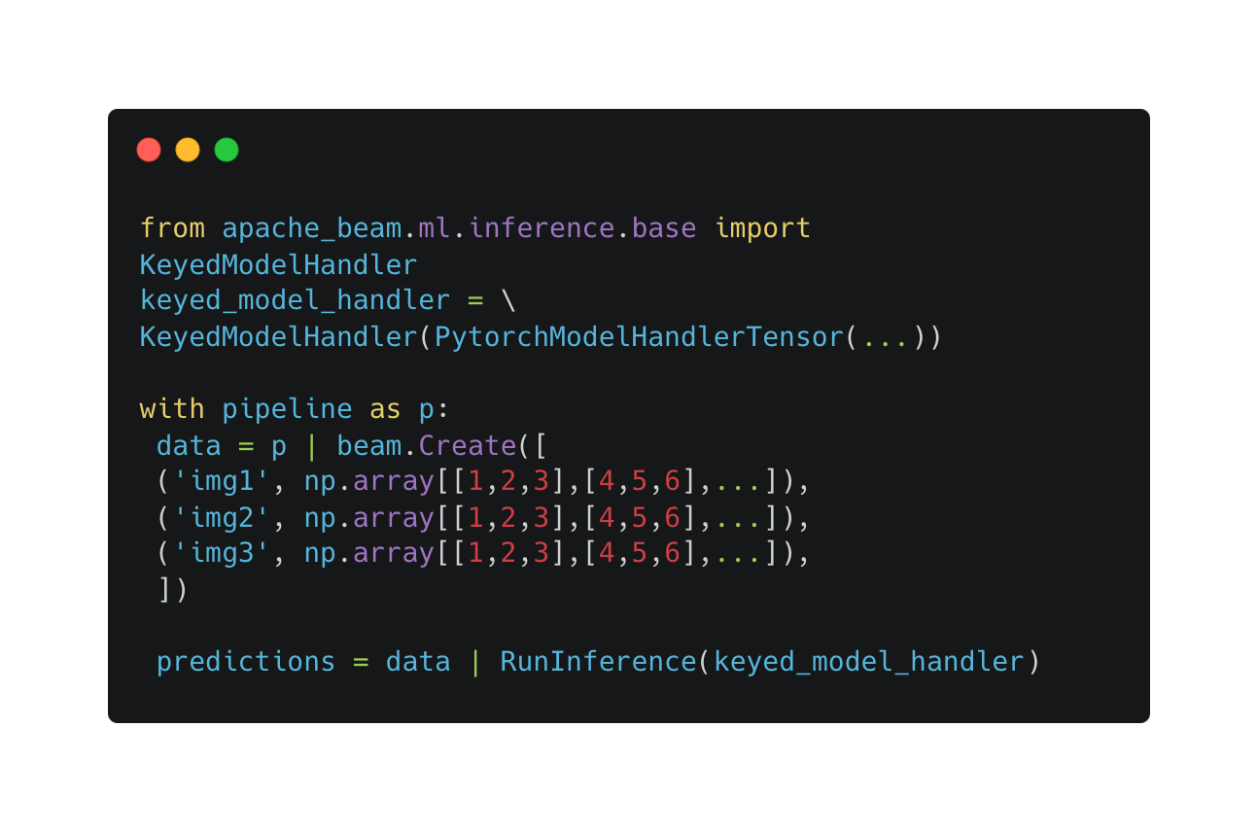
KeyedModelHandler
Notes:
To keep a reference to the image inference is associated with., To aggregate transforms of different inputs., To run postprocessing steps correctly.

Slide 16
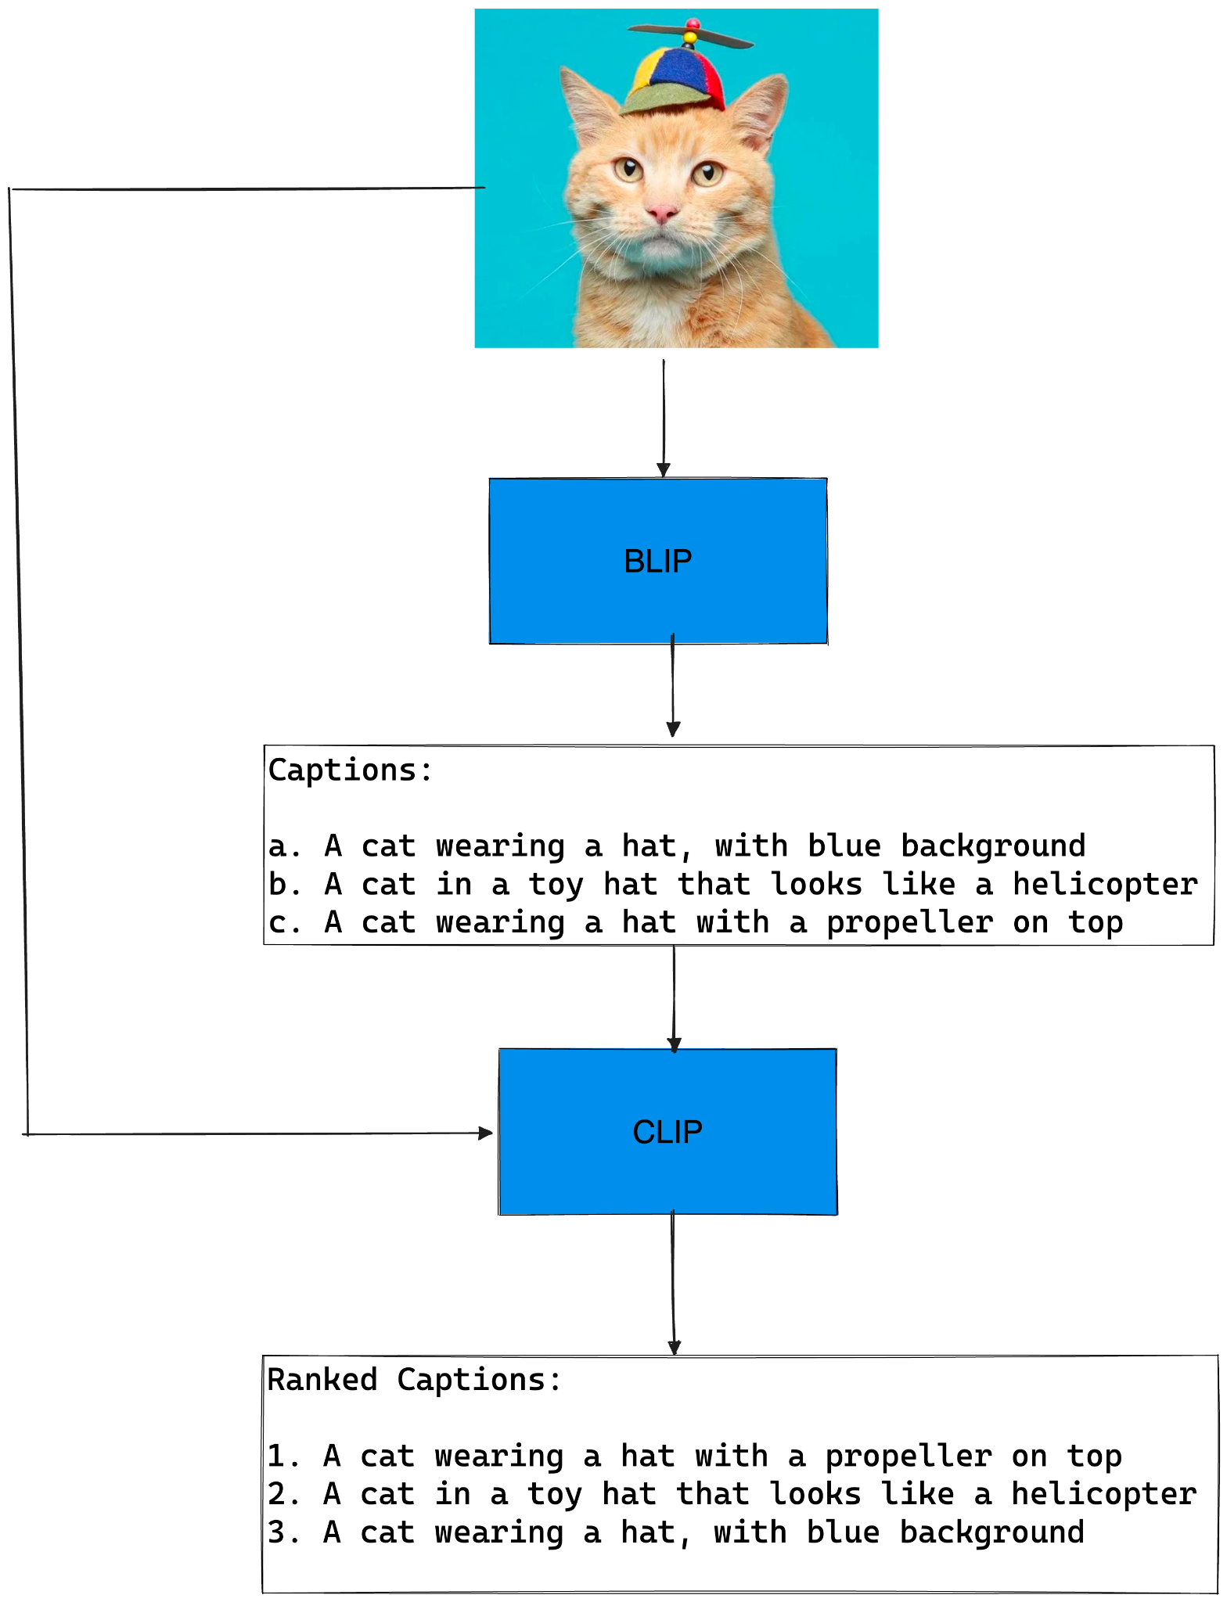
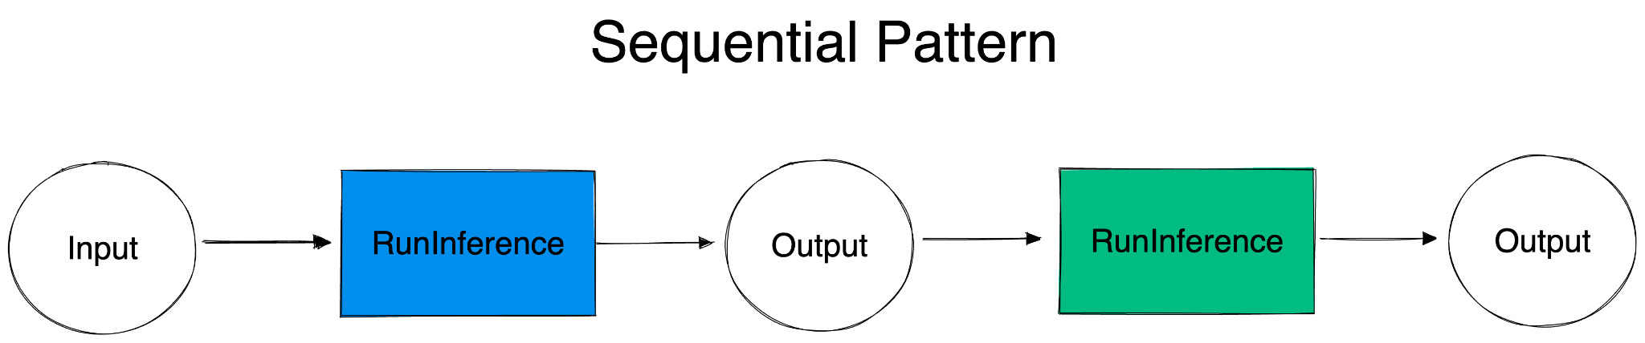
Example
Image captioning and ranking with Sequential Pattern:
BLIP: Image Captioning
CLIP: Ranking captions
Notes:
Let’s deep dive into an example where we walk through a pipeline where we use two models in a sequential fashion
An image is the input to the BLIP model, which gives captions and then they are fed into the CLIP model and in the end you get ranked captions

Slide 17
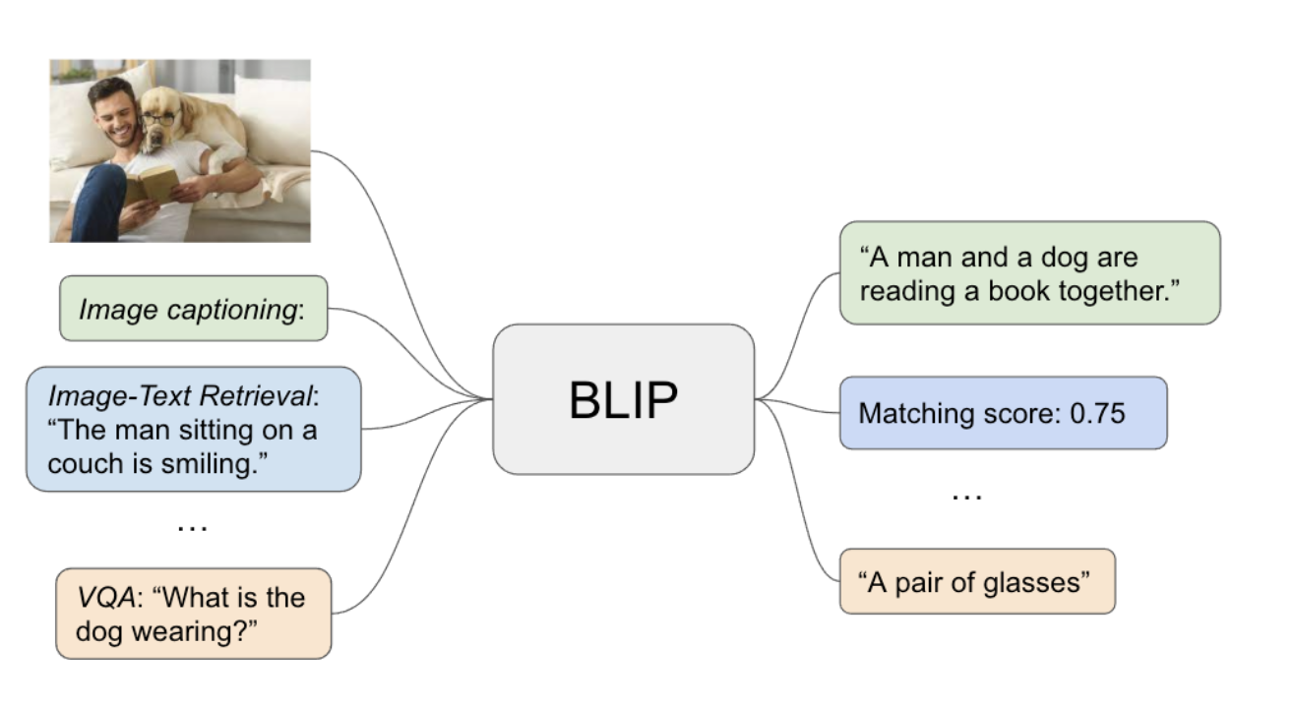
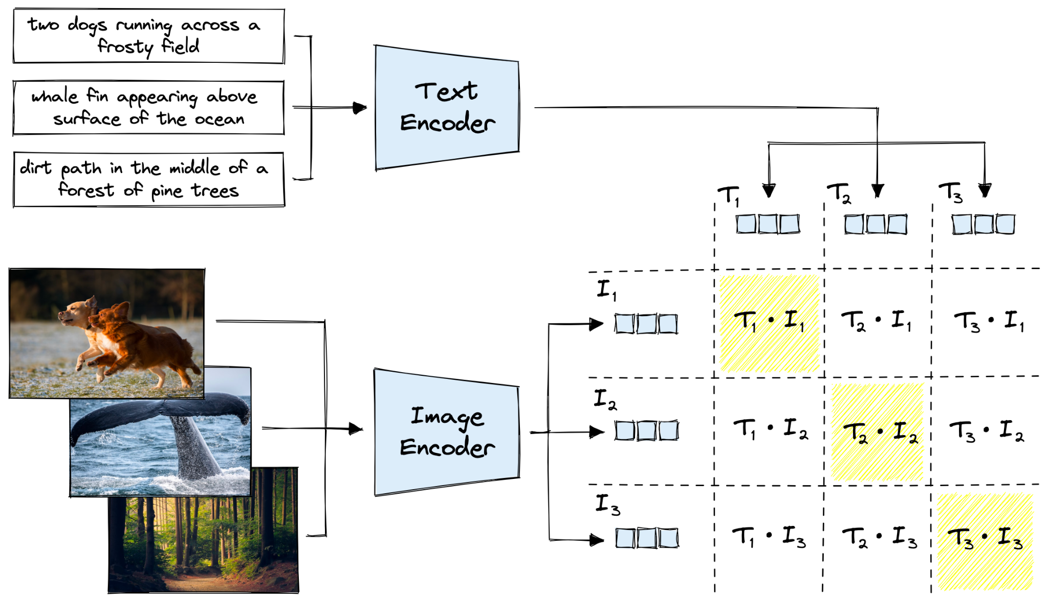
BLIP: Image Captioning
CLIP: Caption Ranking
Notes:
BLIP is a model for image captioning but can do visual question answering and text-to-image similarity
CLIP is another model that maximizes text-image similarity

Slide 18
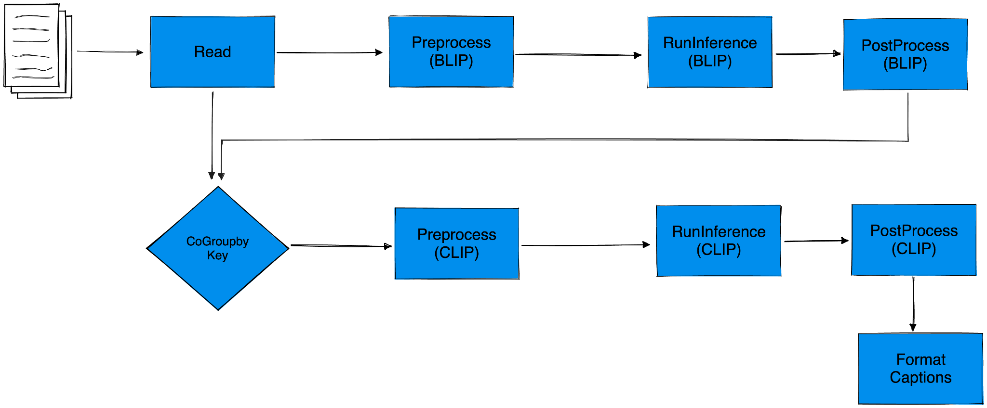
ML Inference Pipeline in Beam as a DAG
[URLs]
Notes:
One can visualize the Entire pipeline as a DAG in this image
Explain the pipeline

Slide 19
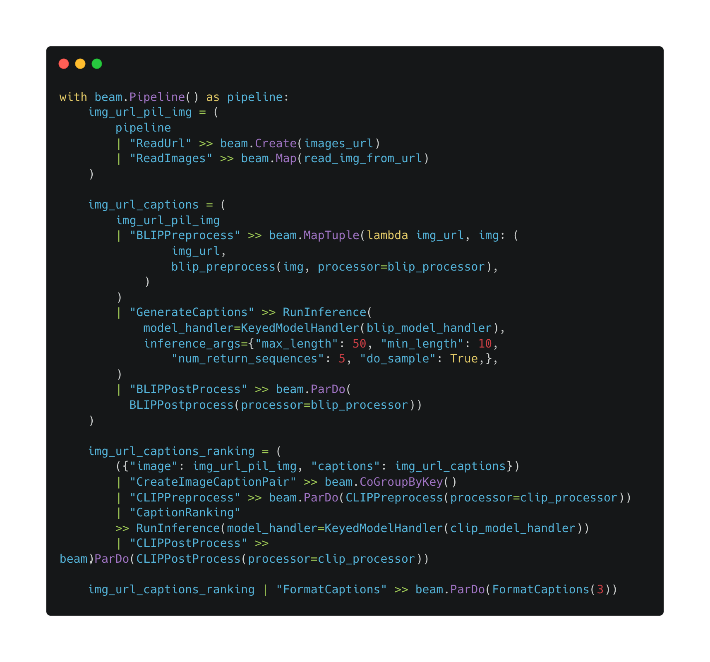
ML Inference Pipeline in Beam as a DAG
Notes:
Here, the pipeline looks complex but it’s quite easy to understand. I will walk through different steps in the next slides

Slide 20
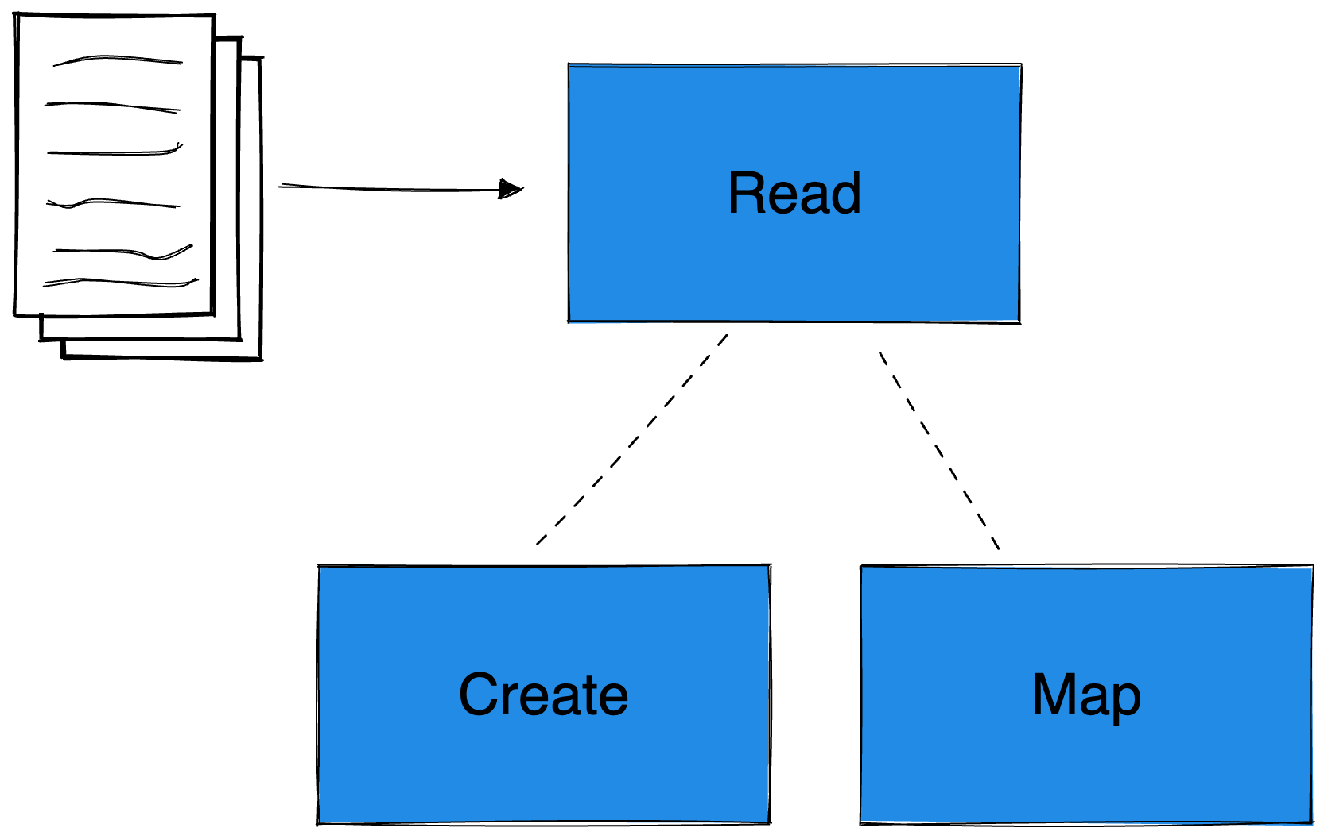
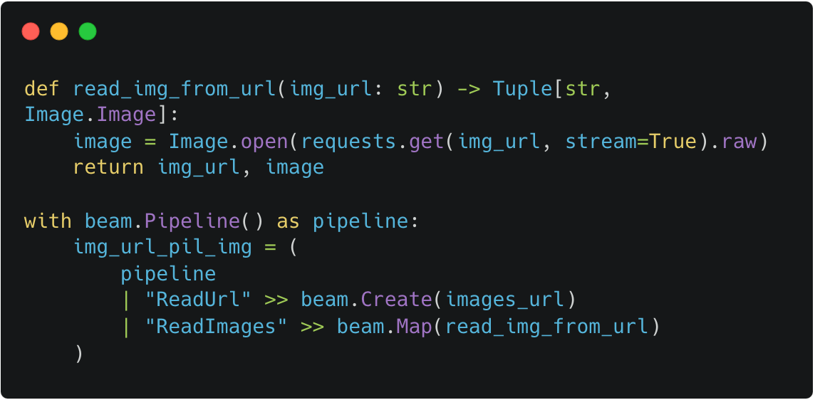
Read Images from URLs
[URLs]
(Img URL, Image)
Notes:
So the reading part basically contains creating a PCollection using list and then getting the Image object using beam.Map
You will get a tuple of (img_url, Image object)

Slide 21
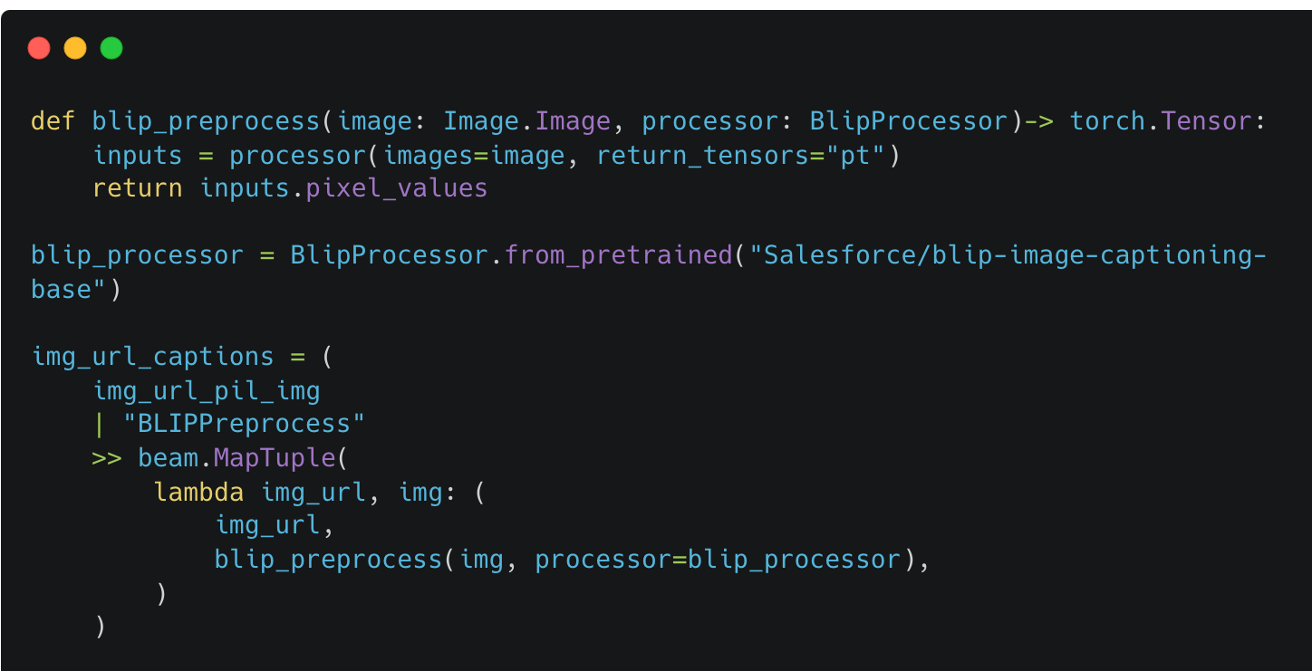
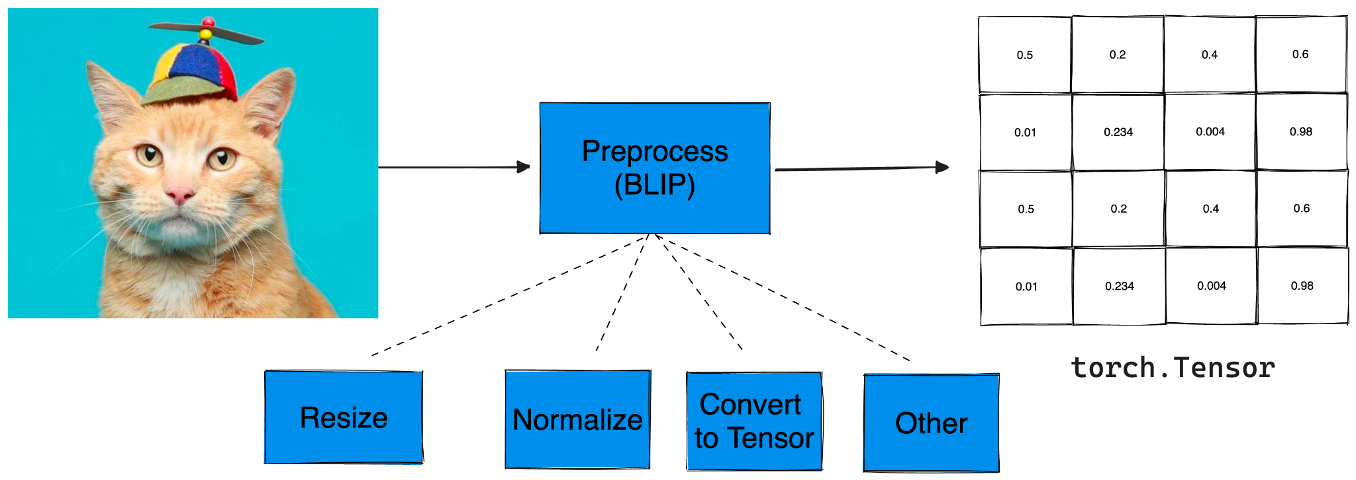

Preprocess Inputs for BLIP
(Img URL, torch.Tensor)
Notes:
So any ML model expects inputs in some certain format, which is often referred to as preprocessing
Here, preprocessing combines different functions like Resizing, Normalizing, Convert to tensor
In the end you get a torch.Tensor along with the URL

Slide 22
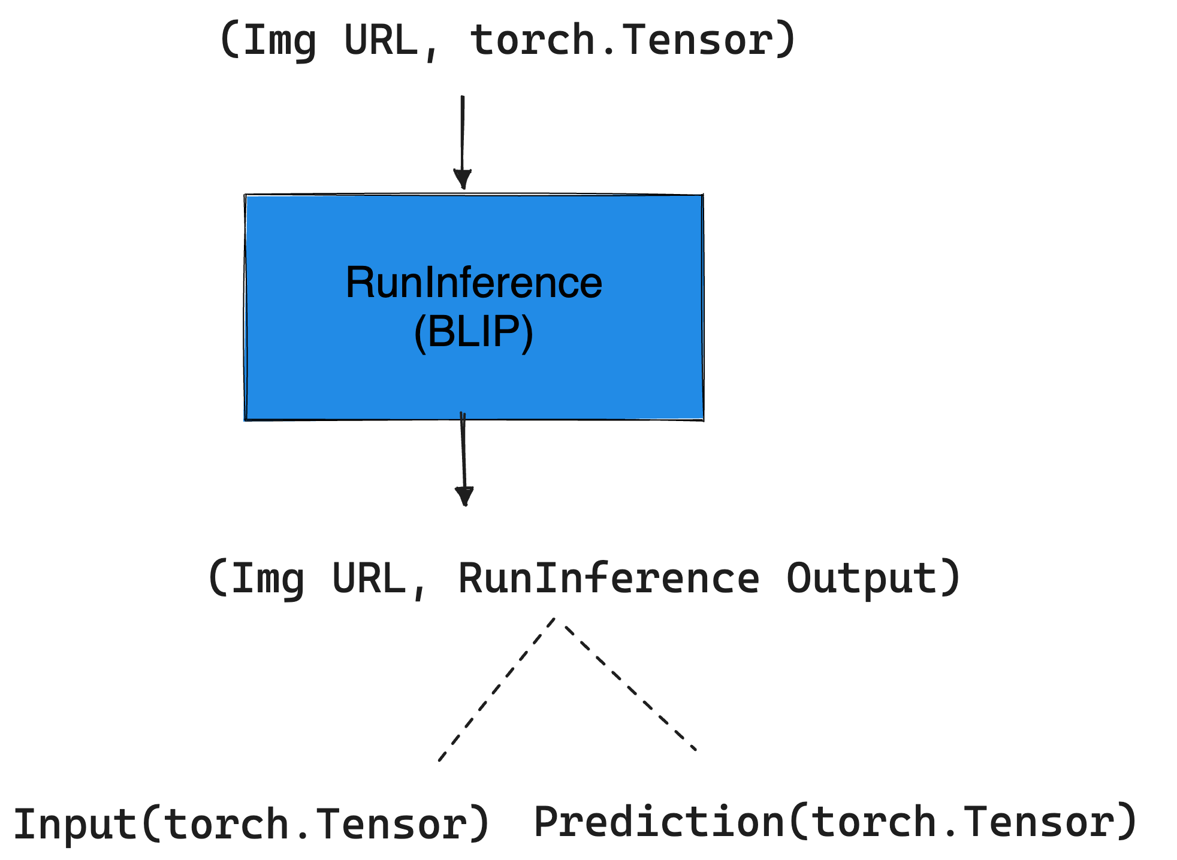
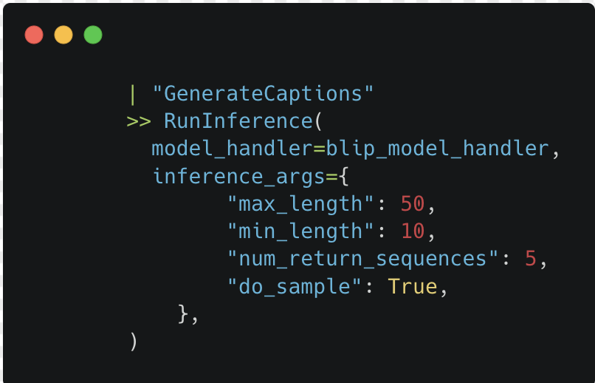
Inference using BLIP
Notes:
Explain the runinference arguments

Slide 23
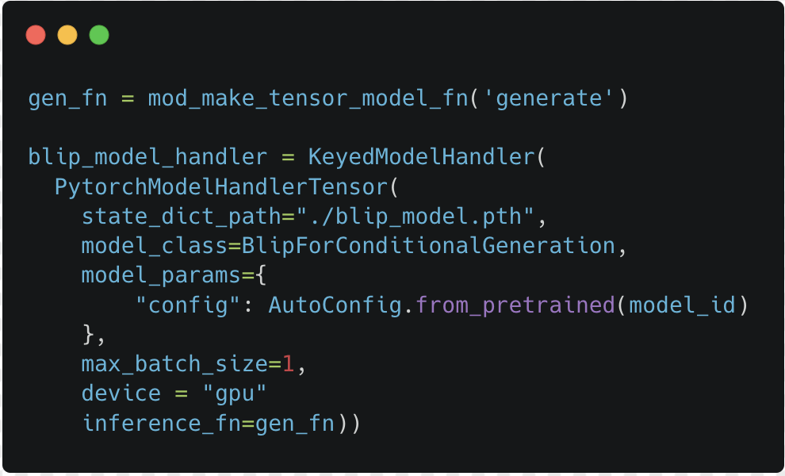
Inference using BLIP
Notes:
Keyed Model Handler
To keep a reference to the image that the inference is associated with.
Might help in transformations like aggregation.

Slide 24
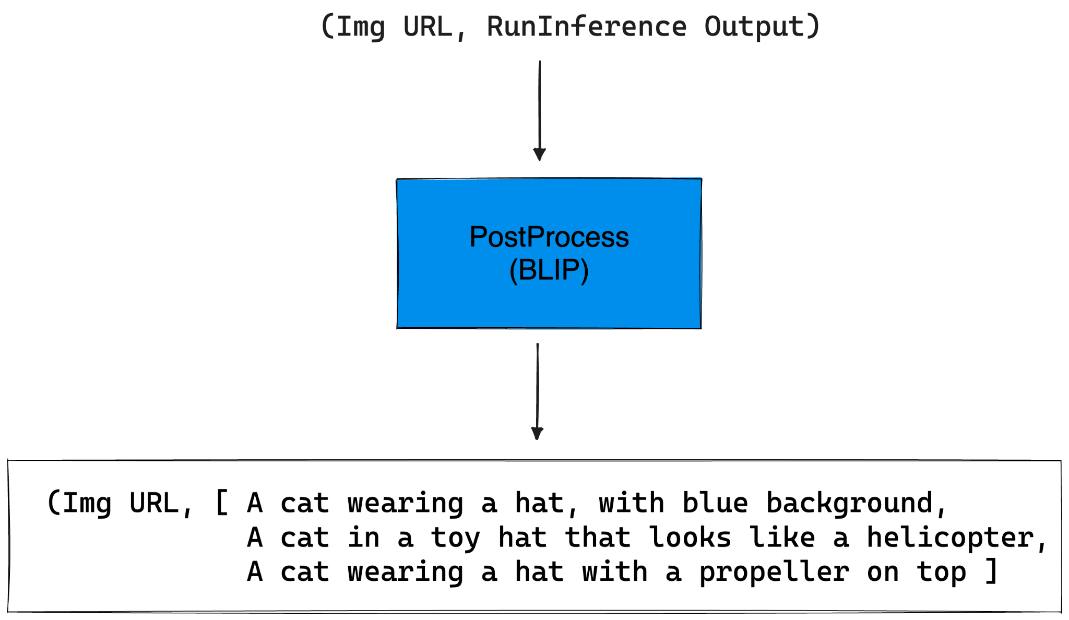
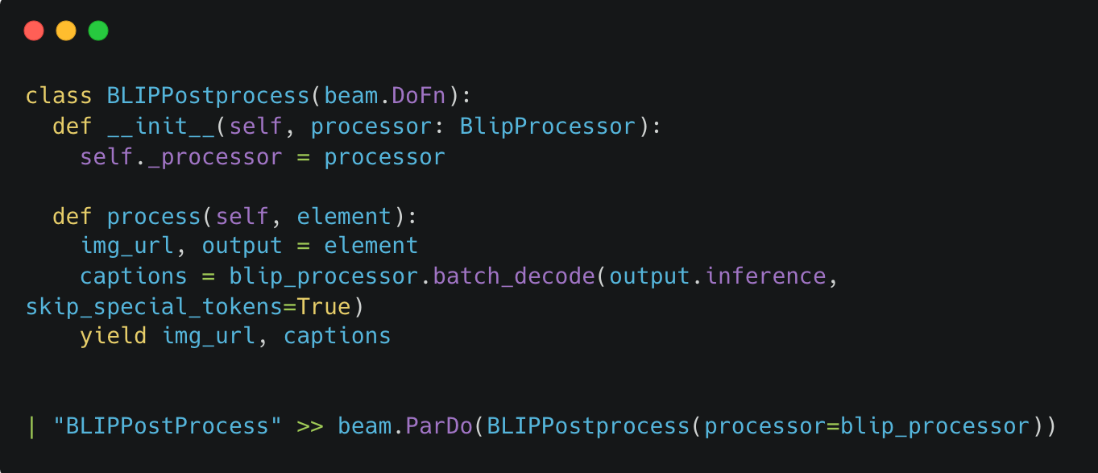
PostProcess BLIP Output

Slide 25
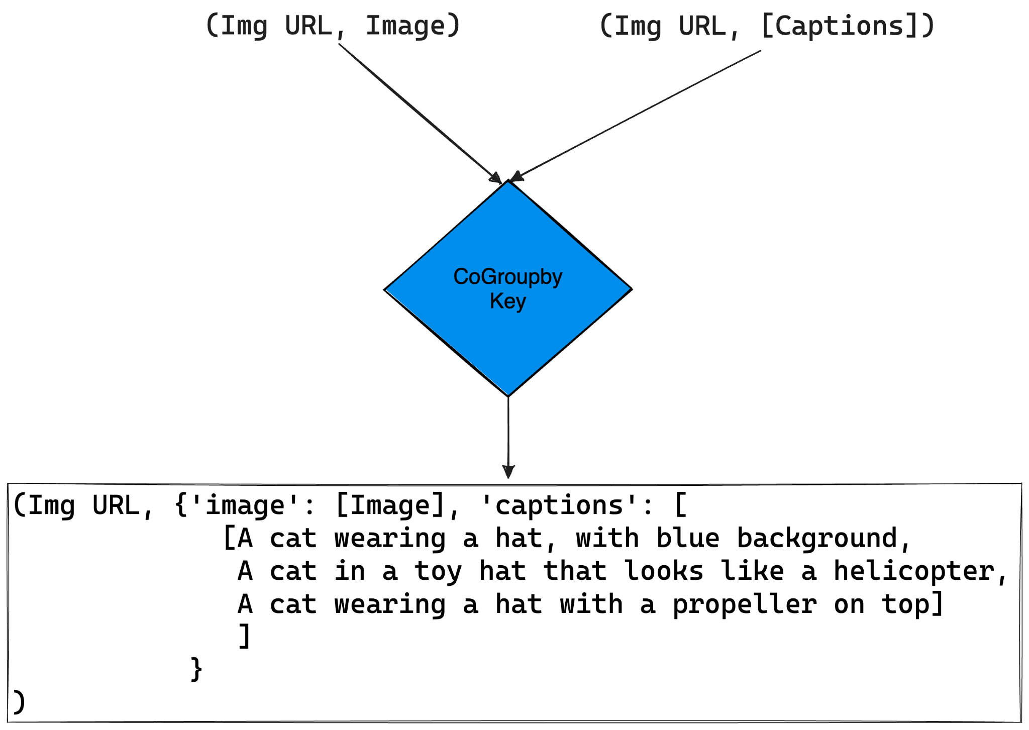
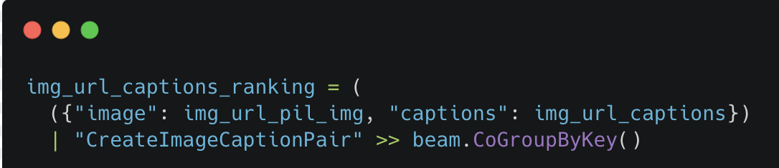
Grouping Image and BLIP Output
Notes:
Grouping so that in a post-process step it will be helpful to know corresponding to which image, the captions are

Slide 26
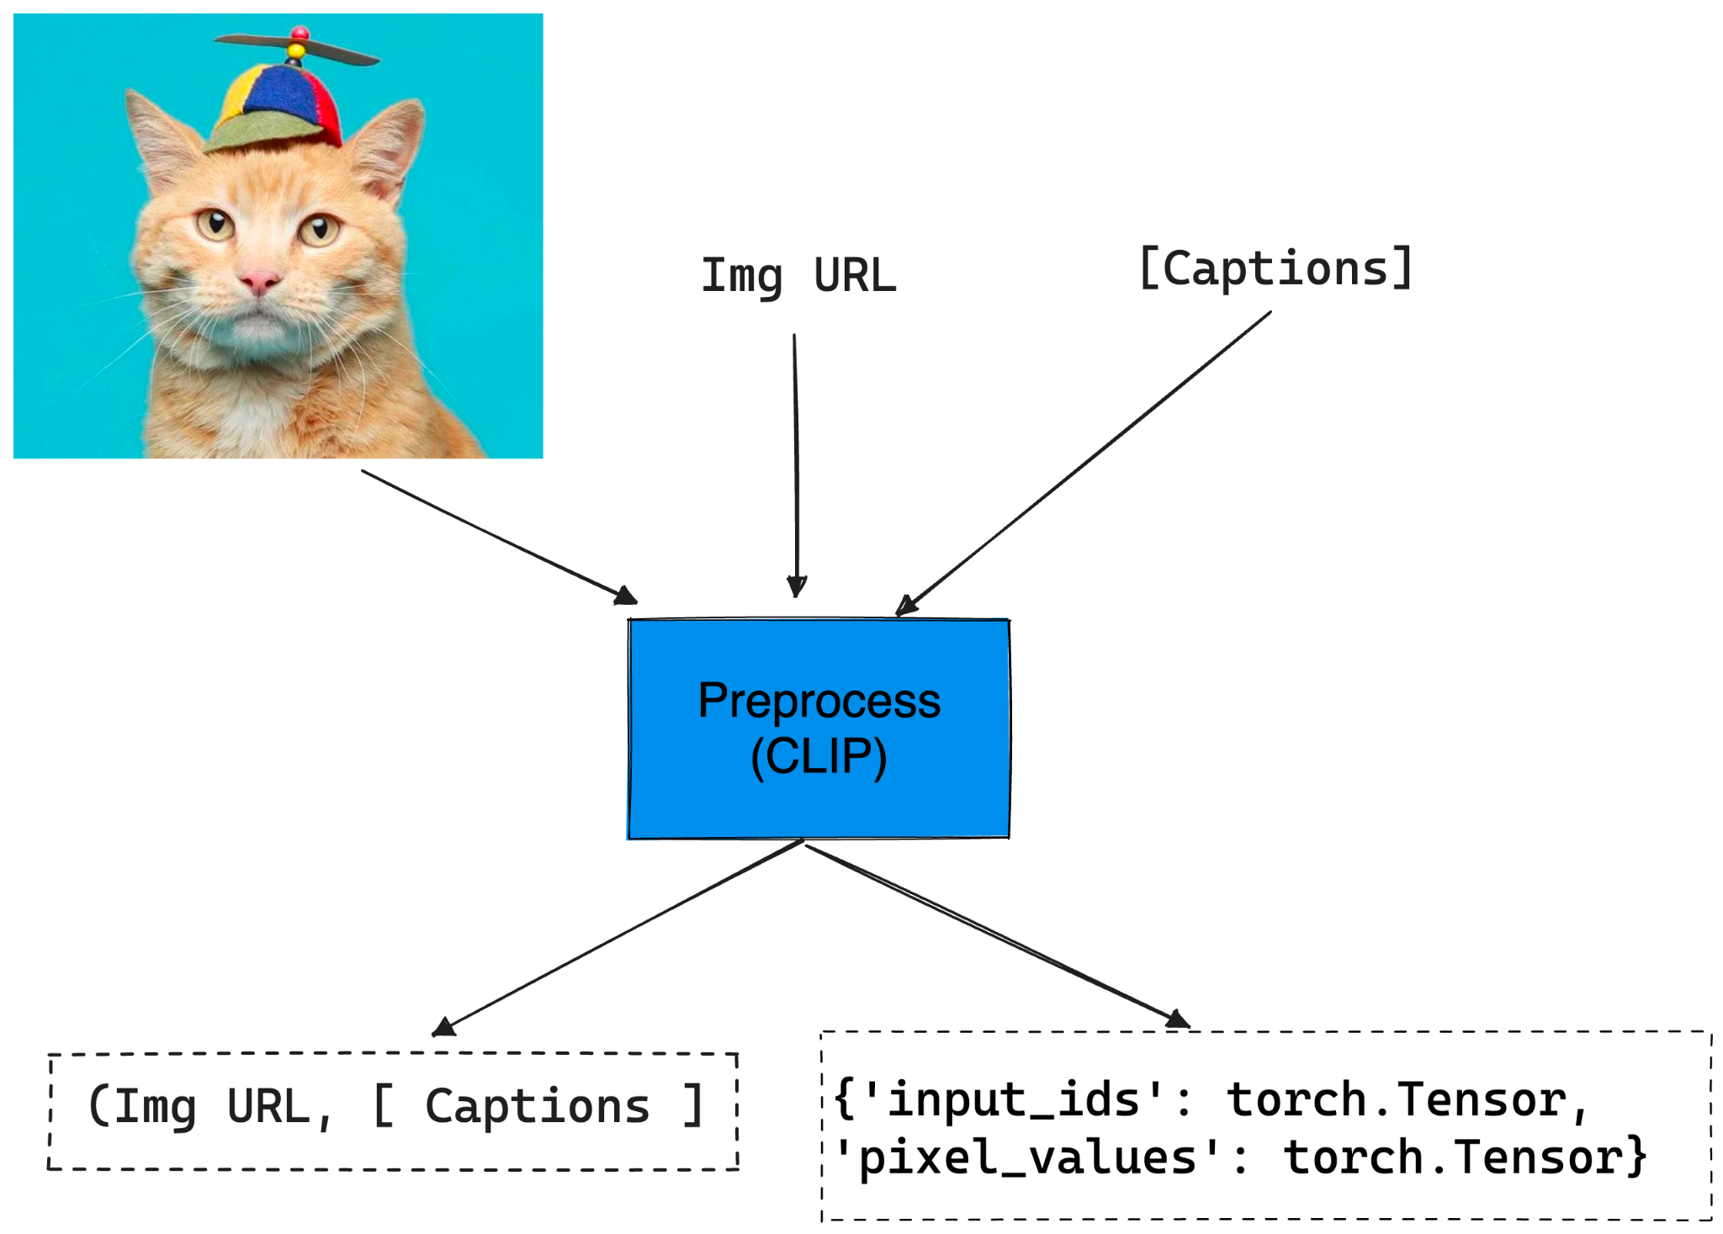
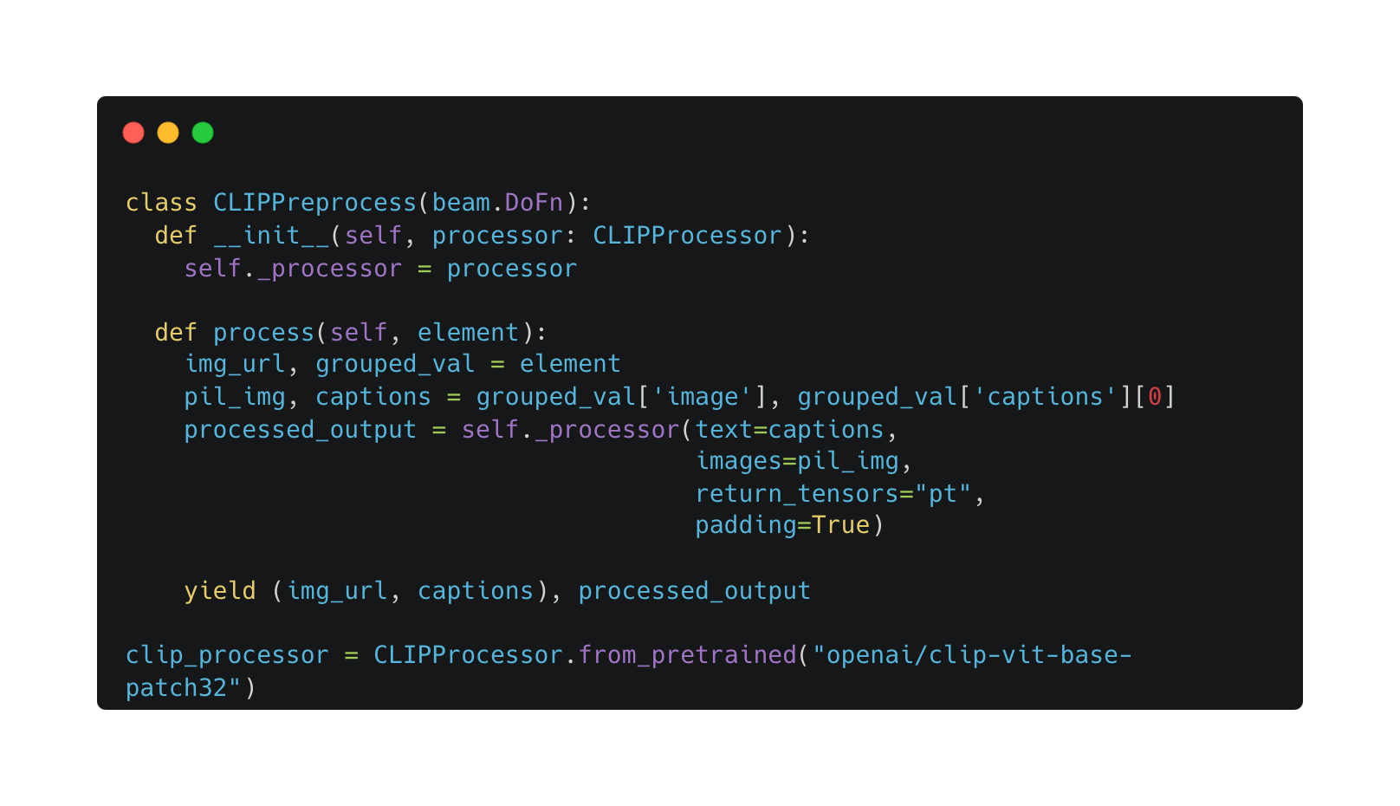
Preprocess Inputs for CLIP

Slide 27
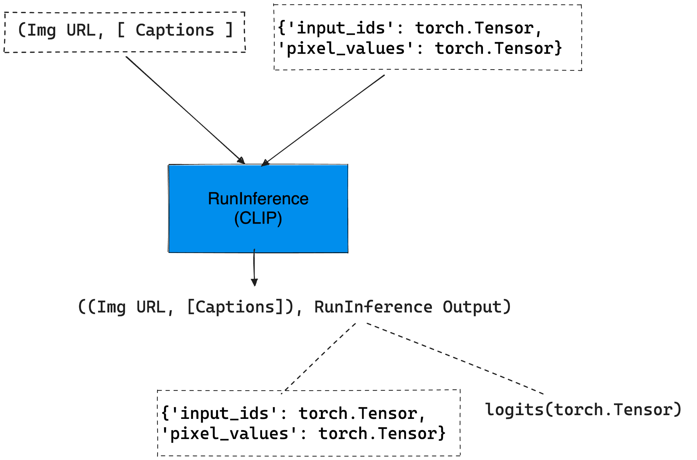
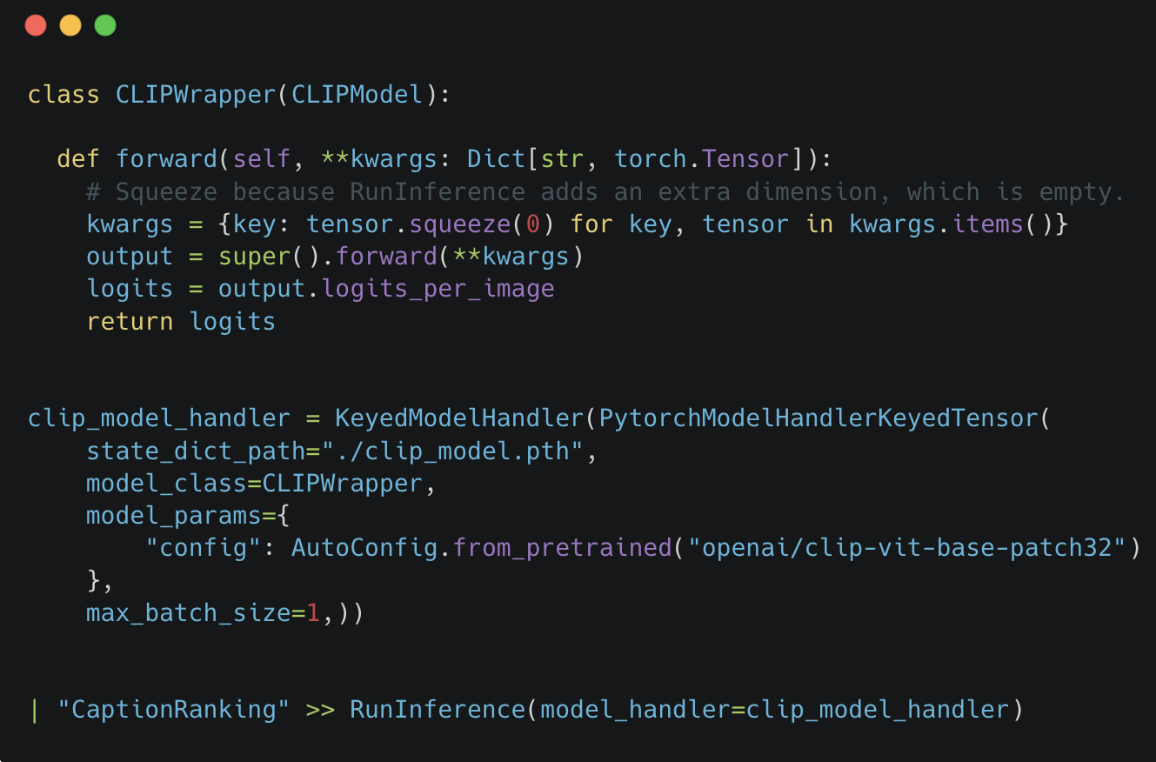
Inference using CLIP
Notes:
By default the RunInference, calls the forward function() for the PyTorch Model, and here we can see that we have overridden the forward function, to squeeze a tensor dimension as Runinference has added extra dimension and the model doesn’t want that extra dimension. You could also change the preprocessing logic to mitigate this

Slide 28
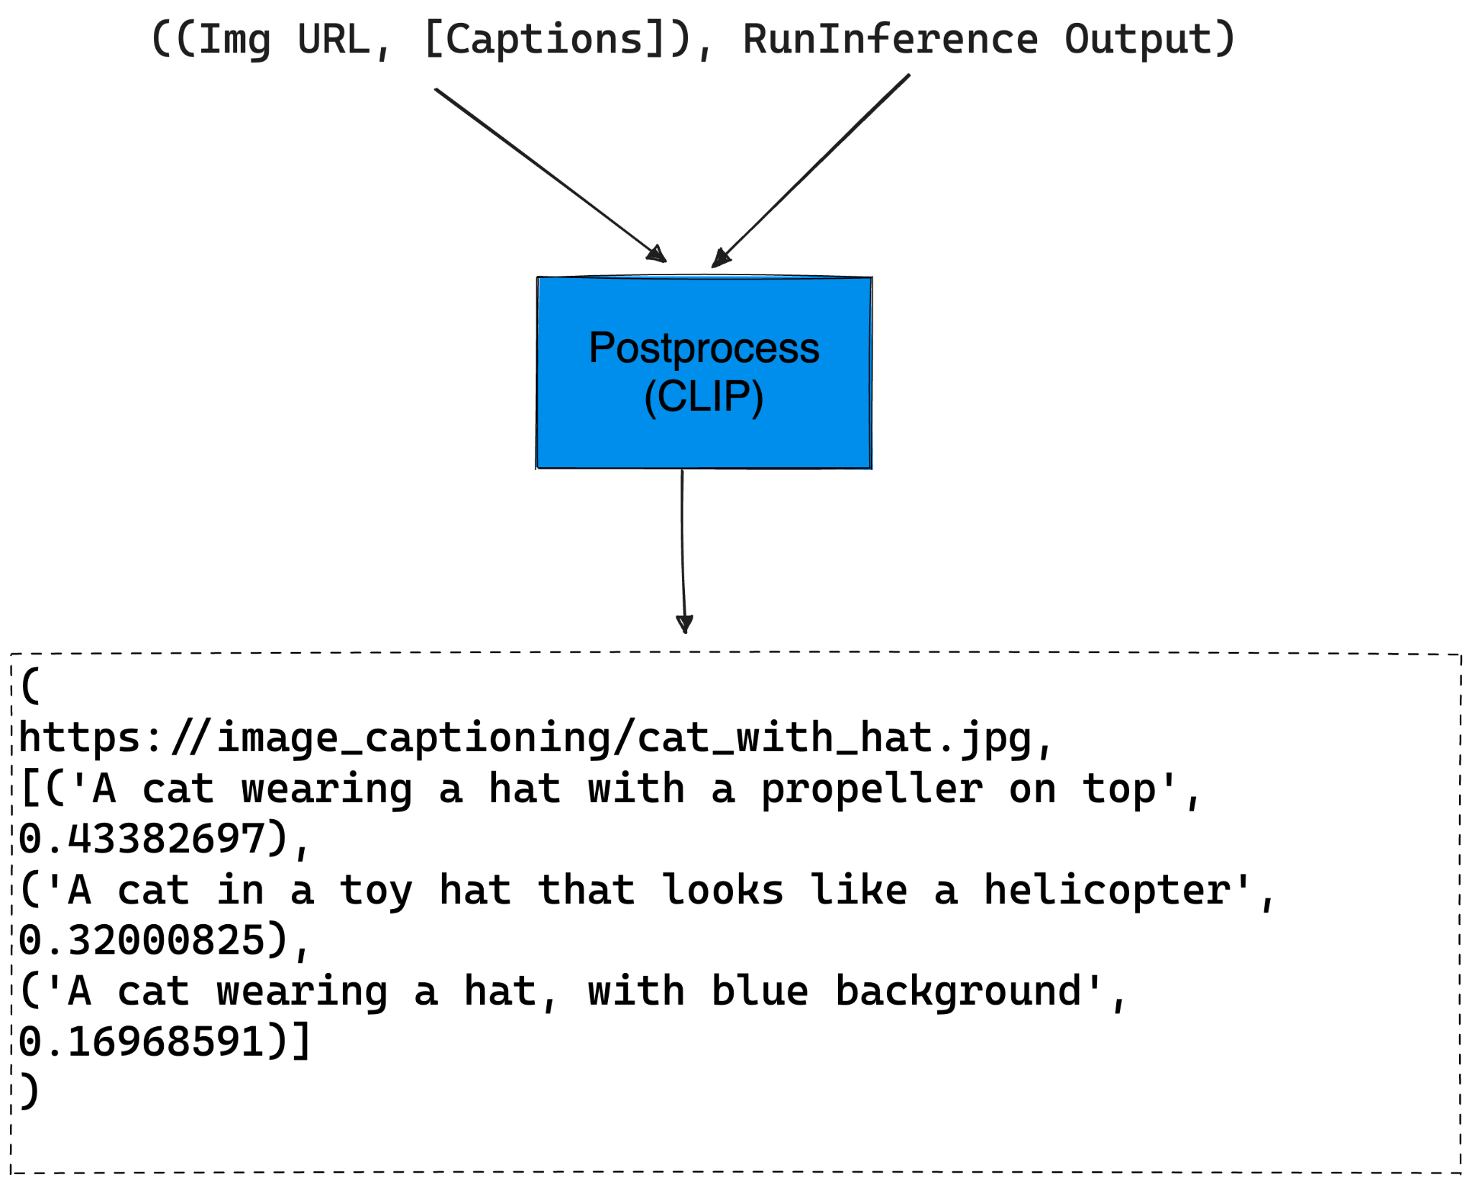
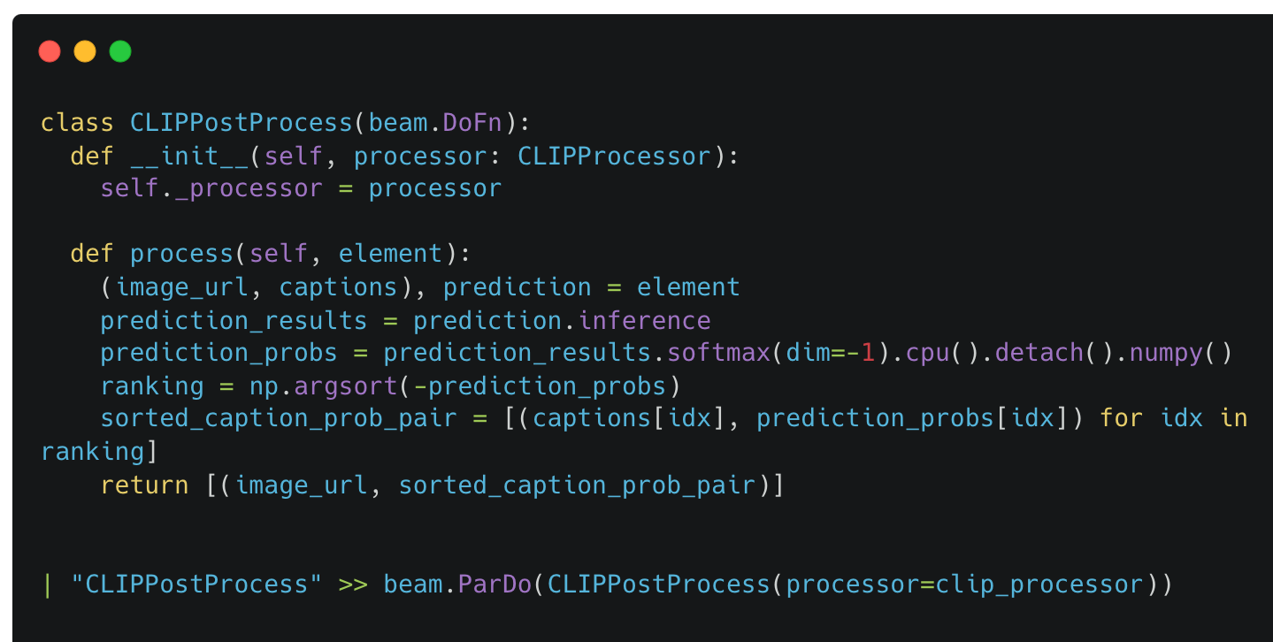
PostProcess CLIP Output

Slide 29
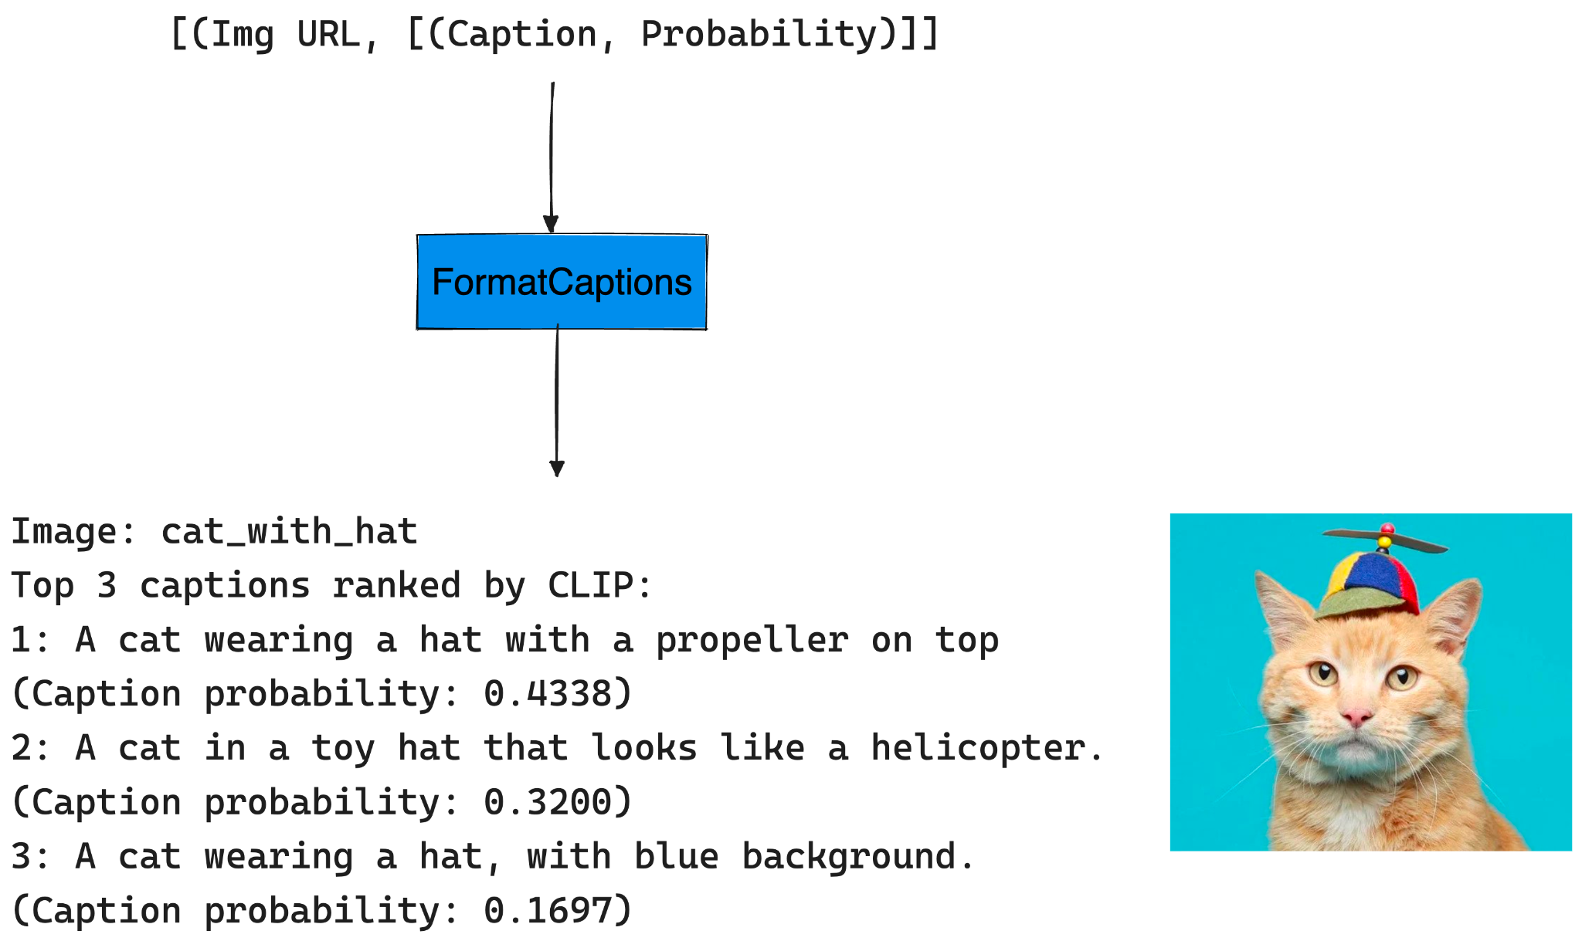
Printing the results nicely

Slide 30
Takeaways
RunInference transform eliminates the need for extensive boilerplate code in pipelines with machine learning models.
Multiple RunInference transforms enable complex pipelines with minimal code for multi-ML models.
Example pipeline can be used for captioning images for finetuning Stable Diffusion.

Slide 31
Code and Tutorial Link
Code: GitHub Link
Tutorial: Apache Beam Documentation Link
Slides: GitHub Link

Slide 32


QUESTIONS?
Shubham Krishna
shubham-krishna-998922108
shub-kris

